Slide 1
NSRA Membership Transformation
1
Presentation to shooting council
November 2019

Slide 2
What is the Board requesting from Shooting Council today?
Agreement in principle with Board proposals
Consult & communicate with membership
Provide feedback on proposals by end January 2020
Any final decision must be data driven and risk managed

Slide 3
Context
The future outlook for NSRA, given current membership levels, is not sustainable
Recruitment and retention of staff is a very real issue
The reputation of the Association is at stake
A significant increase in membership and income would address these issues and allow the Association to tailor and improve services to members
“Doing nothing” is not an option since the Association will lose the critical mass to survive within the next 10 years

Slide 4
The Compelling Imperative to Change – affiliated organisations and clubs 1970 to date
182 clubs lost from 2005 to 2018

Slide 5
The Compelling Imperative to Change – individual members 2005 to date
2036 members lost between 2005 and 2018
Current
year

Slide 6
The Compelling Imperative to Change - income
Group/Charity income is declining
Membership income is flat at best
Expenditure is under control

Slide 7
Two key perceptions were identified at the membership workshop
The NSRA is not effective at communicating to members and potential members
The NSRA does not make effective use of technology or have the right technology

Slide 8
Catch-22
More members = more income
Need more income to get more members

Slide 9
Current Membership
In 2019 there are 982 organisations/clubs and 4909 Life, Annual & Associate members directly supporting the organisation
Approximately 52,000 members of NSRA affiliated clubs receive benefits that are not directly paid for by the individual
Compares to 1815 clubs/48,000 members in 1990 so we now have larger clubs
Many club members are unsure about what insurance cover they receive
Would it NOT be better if all Club members contributed albeit at a reduced rate?

Slide 10
Membership process MUST change
Initial evaluation of membership platforms as used by other NGBs etc
Currently insist that NSRA is unique however systems are not bespoke
Now need to identify internal changes in order to make best use of technology
Need to approach change differently, need to change process to take advantage of new technology
Fears of losing members in droves has not materialised providers will support the organisation & the platform would be available for clubs
Doing nothing is no longer an option

Slide 11
Membership Transformation Proposal
Mandatory membership for all Probationary and Full members of NSRA affiliated clubs
Simple sign up process required – minimal burden for club secretaries – website
Welcome membership pack – first impressions count – very important
Basic Membership (Bronze)
Two levels of individual membership upgrade (Silver & Gold)
Club affiliation £1 – to be confirmed
Affiliation charges for Regions/Counties & other organisations – to be determined

Slide 12
Comparison with other shooting organisations & sports
Leisure Centre £456 (£20 - £38/month Y-Club – Manchester)
London & Middlesex Rifle Association £200
NSRA £50 - £85
NRA £78 - £83.75
BASC £80
CPSA £71
Scottish Target Shooting £10 - £70
Muzzle Loaders GB £60 (+ £20 joining fee)
Archery GB £12 - £54
Swim England £26.75 (low level competition)
England Netball £36.20
Royal Yachting Association £47
England Golf £9 (plus average golf club membership £901*)
*England Golf Questionnaire 2018

Slide 13
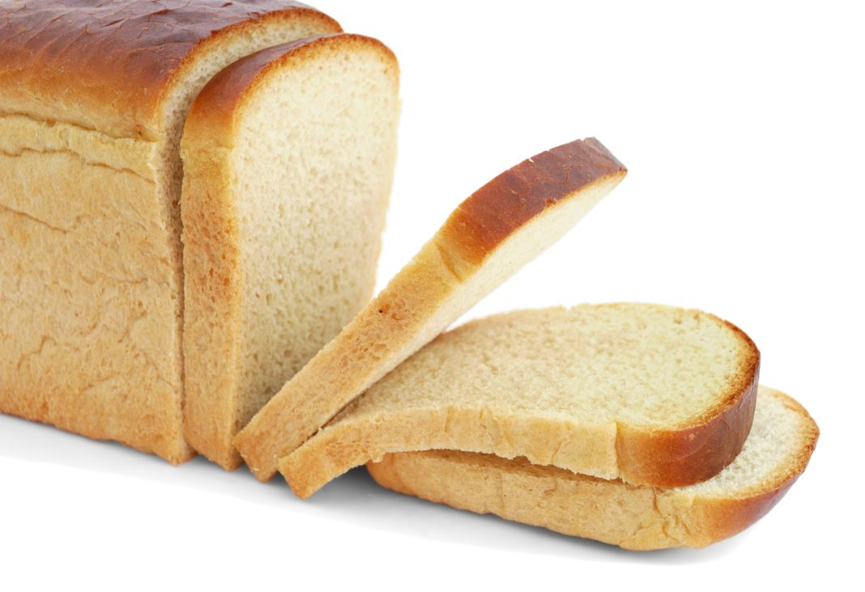
What could be cheaper than a loaf of bread per week?
79p
Tesco crusty white split tin loaf – Oct 2019

Slide 14
“Bronze” membership – cheaper than a loaf of bread a week!
Bronze (basic level) ~£35 (67p/week) would be mandatory for all probationary and full members of NSRA affiliated clubs
Junior members <21 – free with an initial £20 registration fee
Assuming 52,000 members and 85% uptake Bronze membership would generate £884K to £1,547K per annum
Would include public liability
Could include minimal equipment insurance – in UK only (£500 -1000
Free upgrade to Silver membership after 10 consecutive years
See handout for more details

Slide 15
What would “Silver” tier offer?
Silver tier £35 to £45
Assuming 52,000 members and 10% uptake Silver membership could generate £182,000 to £234,000 per annum
Would include public liability
Equipment insurance for UK & EU up to £10,000 all risks
Legal support regarding FAC renewal
Other benefits to be defined

Slide 16
What would “Gold” tier offer?
Gold tier £55 to £85
Assuming 52,000 members and 5% uptake Gold membership would generate £143,000 to £221,000 per annum
Would include public liability
Equipment insurance for Worldwide travel up to £20,000 all risks
Legal support regarding FAC renewal
Other benefits to be defined

Slide 17
What could potential NSRA income be?
Assuming 52,000 members of affiliated clubs
Bronze fee (£20 - £25), Silver (£35 - £45) and Gold (£55 to £85) with 85%, 10% and 5% uptake respectively
Total potential income from mandatory membership £1,209,000 - £1,560,000 (~2 to 2.5 times current income = £608,000 in 2018*)
If only 75% of the 52,000 members of affiliated clubs joined the NSRA in the above proportions income could be between £906,000 and £1,170,000
Regional, County & Club affiliation fees could be significantly reduced
*NSRA Annual Report 2018

Slide 18
What improved services could NSRA provide?
A membership base of ~52,000 members could allow …
Appropriate staffing levels to be reached and staff would be better rewarded, greatly improving reputation and service to members
Lord Roberts Centre and Aldersley to be maintained to a much improved standard
Improvement of National Meetings and Competitions
Educational/PR opportunities to improve perceptions around shooting sports
Expansion of Coaching and Development
An increase in ability to develop juniors
Expansion of shooting disciplines Visually Impaired & Blind Shooting plus Crossbow/Benchrest etc
Partnerships (sponsorship) with relevant companies to flourish
Improved political representation and legal advice
Clubs to apply for funding/grant application adice from the NSRA

Slide 19
Risk Management
Review data on clubs, size, membership, disciplines
Consult closely & visit larger clubs and those with NRA disciplines
Consult very closely with club secretaries
Identify threats and opportunities
All clubs move to NRA and current & future NSRA members told to manage their own membership
Prepare mitigation plans and strategies
Keep all stakeholders fully informed
Communicate, communicate, communicate

Slide 20
The Plan
Consult with Shooting Council - November 2019
Feedback from Shooting Council – by end January 2020
“Roadshows” during 2020 to consult with members of affiliated clubs
Test assumptions with focus groups, especially non-members to define benefits during 2020
Regional Board of Management Meetings with local Q&A sessions in 2020
Target specific clubs eg those with strong NRA affiliation to bring onside
Work with Club Secretaries to work out simple “membership process” - 2020
Identify appropriate technology to effectively and efficiently manage increased membership – direct debits, electronic sign up, payment processing etc. 2020
Roll out new membership structure – 2021/2022

Slide 21
What is the Board requesting from Shooting Council today?
Agreement in principle with Board proposals
Consult & communicate with membership
Provide feedback on proposals by 31 January 2020

Slide 22
Feedback
First impressions?
Questions?
Agree actions (group/individual)

